Slide 1

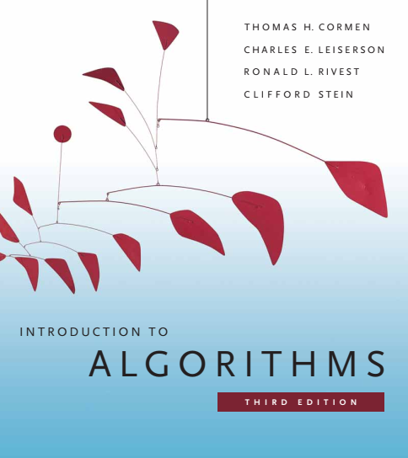
Design and Analysis of Algorithms
Dr. Sajid Iqbal
sajidiqbal.pk@gmail.com
Reference Book
Introduction to Algorithms 3rd Edition By Thomas H. Cormen et. al.
https://mitpress.mit.edu/books/introduction-algorithms-third-edition
COMEDXD

Slide 2
Open Addressing
Chapter 11: hash tables

Slide 3
Introduction
In Open Addressing (OA) an elements is itself placed in hash table and no element is stored outside the table unlike chaining process
Insert: Store the key in table location where it is hashed by hash function
Search: Systematically examine table slots until element is found or table is exhausted
In OA, hash table can be filled
It load factor can never exceed 1
A large table can be used comparatively

Slide 4



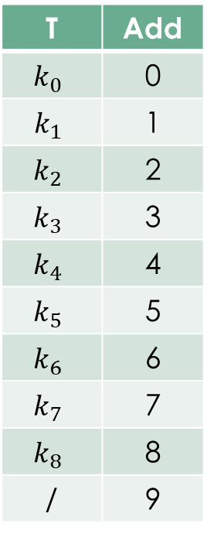






Uniform Hashing
T | Add
$$k_{0}$$ | 0
$$k_{1}$$ | 1
$$k_{2}$$ | 2
$$k_{3}$$ | 3
$$k_{4}$$ | 4
$$k_{5}$$ | 5
$$k_{6}$$ | 6
$$k_{7}$$ | 7
$$k_{8}$$ | 8
/ | 9
$$k_{0}$$
0
$$k_{1}$$
$$k_{2}$$
$$k_{3}$$
$$k_{4}$$
$$k_{5}$$
$$k_{6}$$
$$k_{7}$$
$$k_{8}$$
M-1

Slide 5
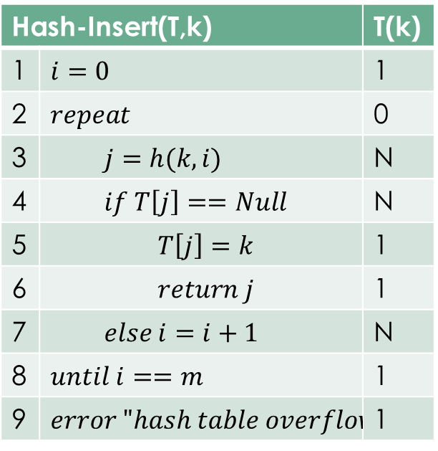

Probing
Probing: A process to search for empty slot in table
A free location can be found using probing and element is inserted there
The sequence of positions probed depends upon the key being inserted
A modified hash function $h\left(k,p\right)$ is used instead of $h(k)$ where p is probe number
Hash-Insert(T,k) |  | T(k)
1 | $$i=0$$ | 1
2 | $$repeat$$ | 0
3 | $$j=h(k,i)$$ | N
4 | $$if T\left[j\right]==Null$$ | N
5 | $$T\left[j\right]=k$$ | 1
6 | $$return j$$ | 1
7 | $$else i=i+1$$ | N
8 | $$until i==m$$ | 1
9 | $$error "hash table overflow"$$ | 1

Slide 6
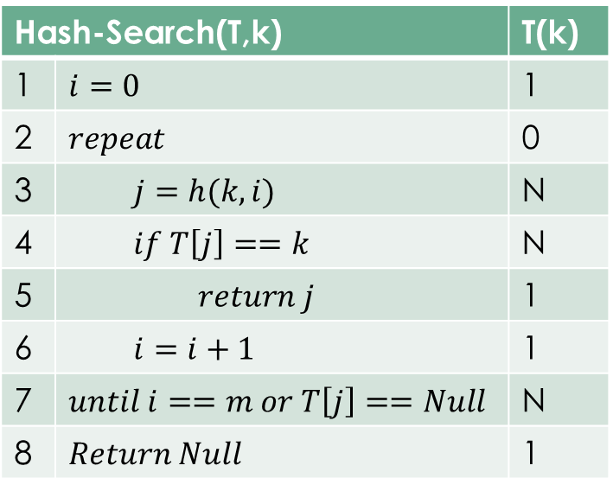
Searching in Hash Table
Search for key k probes the same sequence of slots that the insertion algorithm examined
Unsuccessful search: Algorithm either finds the empty slot or complete table is examined
Hash-Search(T,k) |  | T(k)
1 | $$i=0$$ | 1
2 | $$repeat$$ | 0
3 | $$j=h(k,i)$$ | N
4 | $$if T\left[j\right]==k$$ | N
5 | $$return j$$ | 1
6 | $$i=i+1$$ | 1
7 | $$until i==m or T\left[j\right]==Null$$ | N
8 | $$Return Null$$ | 1

Slide 7

Uniform Hashing
A conceptual method of open addressing for a hash table.
The probe sequence is equally likely to be any of $m!$ Permutations for table slots $T=\{0,1,2,3,…,m−1\}$
A collision is resolved by putting the item in the next empty place given by a probe sequence which is independent of sequences for all other key i.e. each probe sequence is independent
Exact uniform hashing is difficult to implement so its approximations are used
There are three common approaches to compute probe sequences
Linear probing,
Quadratic probing,
Double hashing

Slide 8
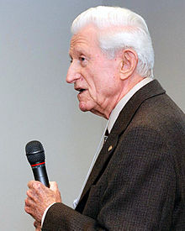

Linear Probing
A simple method of collision avoidance
If collision occurs the colliding record next in hash table
Let consider an auxiliary hash function
$h^{′}\left(k\right) h^{′}:U→\left\{0,1,2,…,m−1\right\}$
$h\left(k,i\right)=\left(h^{′}\left(k\right)+i\right) mod m$
Probe $T[h^{′}\left(k\right)]$ the slot given by auxiliary function
Next probe $T[h^{′}\left(k\right)+1]$ and so on upto slot $T[m−1]$
After end of table, begin from start of table upto $T[h^{′}\left(k\right)−1]$
Issue
$Primary clustering:$ long runs of occupied sequences. The keys are not well distributed among all slots
Clustering is produced due to $ith$ slot after $i−1$ filled slots is gets filled with probability $(i+1)/m$.
Long runs of occupied slots tend to get longer and the average search time increases
 | T
0
1
2
3
4
5
6
7
8
9
Gene Amdahl
1922-2015
71
64
36
56

Slide 9

Quadratic Probing
This technique uses the hash function of the type
$h\left(k,i\right)=\left(h^{′}\left(k\right)+c_{1}i+c_{2}i^{2}\right) mod m$
Where
$h^{′}\left(k\right):$ an auxiliary function
$c_{1}, c_{2}$are auxiliary constants
$i=\{0,1,2,…,m−1\}$
Probing Sequence
Initial probing is $T\left[h^{′}\left(k\right)\right]$
Next probes are offset by amount that depend in quadratic manner on probe number I
This method works much better than linear probing
If two keys have same initial probe, their probe sequence will also be similar
This creates the situation known as secondary clustering

Slide 10

Double hashing
It offers one of the best methods available for open addressing
Double hashing uses hash function of the form
$h\left(k,i\right)=\left(h_{1}\left(k\right)+ih_{2}\left(k\right)\right) mod m$
Where $h_{1}and h_{2}$ are auxiliary functions
Initial probe find the position $T\left[h_{1}\left(k\right)\right]$ with next probe position as offset from previous position $h_{2}\left(k\right) mod m$
The value of $h_{2}(k)$ must be relatively prime to the hash table size m
When m is prime or a power of 2, double hashing improves over linear or quadratic probing

Slide 11

Analysis of open-address hashing
To analyze the behavior of open addressing, load factor $α=n/m$ is used
In open addressing each element occupies only one slot so $n≤m with α<1$
Inserting an element may follow any permutation of hash table $T=\left\{0,1,2,3,…,m−1\right\}$ of equally likely

Slide 12

Theorem 11.6
Theorem
Assuming uniform hashing for open address hash table with $α<1.$ Expected number of probes in an unsuccessful search is at most $\frac{1}{1−α}$
Proof
An unsuccessful search probes filled keys except the last one which may be empty
Let $X$ is random variable that denotes the unsuccessful probes
$A_{i}$ is the event that $ith$ probe occurs in occupied slot
$.{Pr\left\{X>i\right\}}=Pr\left\{A_{1}∩A_{2}∩…∩A_{i−1}\right\}=\operatorname{Pr}\left\{A_{1}\right\}∗\operatorname{Pr}\left\{A_{2} | A_{1}\right\}∗\operatorname{Pr}\left\{A_{3} | A_{1}∩A_{2}\right\}∗…∗Pr⁡(A_{i−1}|A_{1}∩A_{2}∩…∩A_{i−2}\}$
There are n elements then $P\left\{A_{1}\right\}=\frac{n}{m}$
For $j>1$, prob. Of $j^{th}$ prob. to occupied slot gives $that (j−{1)}^{th}$ probes were to occupied slots too
= $Pr(j_{occupied−probe})=\frac{\left[n−\left(j−1\right)\right]}{\left[m−\left(j−1\right)\right]}=$ $\frac{n−j+1}{m−j+1}$

Slide 13

$pr\left\{X≥i\right\}=\frac{n}{m}∗\frac{n−1}{m−1}∗\frac{n−2}{m−2}∗ …∗\frac{n−i+2}{m−i+2}$
$≤{\left(\frac{n}{m}\right)}^{i−1}=α^{i−1}$
$E\left[X\right]=\sum_{i=1}^{∞}{Pr⁡\{X≥1}\}$
$≤\sum_{i=1}^{∞}{α^{i−1}}$
= $\sum_{i=1}^{∞}{α^{i}}$
$=\frac{1}{1−α}$ using arithmetic progression formula
$\frac{1}{1−α}=1+α^{1}+α^{2}+α^{3}$
First probe is made with probability $α^{1}$ and second probe is made with probability $α^{2}$ and so on
If $α$ is constant then unsuccessful search runs in O(1) time
For example if table is half full then number of probes are $\frac{1}{1−0.5}=2$ and in case of 90% full table , number of probes are 10.

Slide 14

Theorem 11.8
Theorem
Given an open address hash table with load factor $α<1$, the expected number of probes for successful search is at most $\frac{1}{α}ln⁡(\frac{1}{1−α})$ assuming uniform hashing
Proof
A search for key k produces the same sequence which is produced for insert
To insert i+1st key into the table expected number of probes are at most
$\frac{1}{1−α}=\frac{1}{1−\frac{i}{m}}=\frac{m}{m−i}$
Averaging this expression over all keys gives the expected search time

Slide 15

$\frac{1}{n}\sum_{i=0}^{n−1}{\frac{m}{m−1} }$
$\frac{m}{n}\sum_{i=0}^{n−1}{\frac{1}{m−1} }$
$\frac{1}{α}\sum_{i=0}^{n−1}{\frac{1}{m−1} }$
$\frac{1}{α}\sum_{k=m+n−1}^{m}{\frac{1}{k} }$
$\frac{1}{α}\ln{\frac{m}{m−n}}$
$\frac{1}{α}\ln{\frac{1}{1−n/m}}$
$\frac{1}{α}\ln{\frac{1}{1−α}}$
If the hash table is half full, the expected number of probes in a successful search is less than 1:387.
If the hash table is 90 percent full, the expected number of probes is less than 2:559.

Slide 16



Thanks for watching
Dr. Sajid Iqbal
Assistant Professor
Department of Computer Science
Bahauddin Zakariya University, Multan
sajidiqbal.pk@gmail.com
https://github.com/sajjo79/Design_and_Analysis_of_Algorithms
COMEDXD
Allah Hafiz

